Slide 1
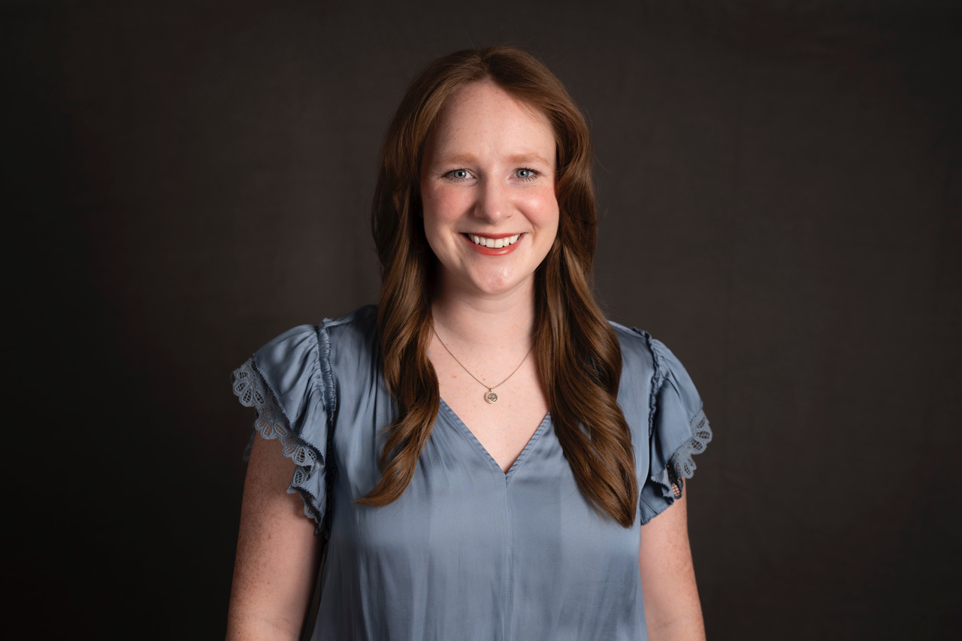
Haley Hodde Sr. Consultant — Acceleration
Email
Haley.hodde@thebridge.com
Location
Dallas, Texas
Mobile
(214) 469-6892
Haley joined the Bridge in July 2024, bringing with her a diverse set of experiences in business transformation. Her approach is personable and curious. She partners with her clients to develop strategic, thoughtful and creative solutions that blend industry wisdom with innovation.
EXPERIENCE
Industry Experience
Electric Utility | Healthcare | Commercial Real Estate | Construction | Nonprofit
Talent Development | Utilities
Drove the realization of company values by crafting innovative leadership development curriculums, review cycle materials, and continuous performance management plans to empower a goal-oriented growth culture.
Change Management and Process Optimization | Healthcare
Change Management: Developed communications and training material in support of organization-wide change from a paper tracking process to digital record software in compliance with industry standard processes.
Process Optimization: Conducted 20+ discovery and design workshops, reimagining their product lifecycle to align with use cases and support business growth initiatives. Developed data structure framework to support execution of the strategy.
Organization Development and Marketing | Commercial Real Estate Construction
Organizational Development: Restructured company organization to clarify responsibility, eliminate redundant processes, and highlight opportunities for growth. Recruited for and successfully filled the first phase of new positions during the height of an industry-wide staffing shortage, systematizing the hiring and review process along the way.
Marketing and Branding: Directed company rebrand, leading research, strategy and design. Established mission and vision statements, migrated and rebuilt website, and managed the production of visual assets and print collateral to reach a new target audience.
BACKGROUND
Functional Skills
Talent Optimization, Workshop Design & Facilitation, Change Management, Strategic Communications, Business Analysis, Due Diligence, Organizational Design, Process Design / Optimization, Graphic Design and Marketing
Qualifications
A business transformation Consultant with experience in improving operational efficiency, employee performance and talent optimization, and driving positive outcomes for organizational change.

Slide 2
Haley Hodde Sr. Consultant — Acceleration
Email
Haley.hodde@thebridge.com
Mobile
(214) 469-6892
Location
Dallas, Texas
BACKGROUND
EXPERIENCE
Functional Skills
Talent Optimization, Workshop Design & Facilitation, Change Management, Strategic Communications, Business Analysis, Due Diligence,
Organizational Design, Process Design / Optimization, Graphic Design and Marketing
Qualifications
A business transformation Consultant with experience in improving operational efficiency, employee performance and talent optimization, and driving positive outcomes for organizational change.
Industry Experience
Utilities | Healthcare | Commercial Real Estate | Construction | Nonprofit
Talent Development | Utilities
Drove the realization of company values by crafting innovative leadership development curriculums, review cycle materials, and continuous performance management plans to empower a goal-oriented growth culture.
Change Management and Process Optimization | Healthcare
Change Management: Developed communications and training material in support of organization-wide change from a paper tracking process to SaaS in compliance with industry standard processes.
Process Optimization: Conducted 20+ discovery and design workshops, reimagining their product lifecycle to align with use cases and support business growth initiatives. Developed data structure framework to support execution of the strategy.
Organization Development and Marketing | Commercial Real Estate Construction
Organizational Development: Restructured company organization to clarify responsibility, eliminate redundant processes, and highlight opportunities for growth. Recruited for and successfully filled the first phase of new positions during the height of an industry-wide staffing shortage, systematizing the hiring and review process along the way.
Marketing and Branding: Directed company rebrand, leading research, strategy and design. Established mission and vision statements, migrated and rebuilt website, and managed the production of visual assets and print collateral to reach a new target audience.

Slide 3

Email
Haley.hodde@thebridge.com
Location
Dallas, Texas
Mobile
(214) 469-6892
Haley joined the Bridge in July 2024, bringing with her a diverse set of experiences in business transformation. Her approach is personable and curious. She partners with her clients to develop strategic, thoughtful and creative solutions that blend industry wisdom with innovation.
Haley Hodde Sr. Consultant
Acceleration

